Slide 1

IMDB Movie Analysis
Final Project-1
By Ashutosh Singh

Slide 2
Project Description
Utilizing IMDB-movie dataset to derive meaningful insights like popular genres, top directors, most profit-making movies.
Deeper insights like impacts on IMDB ratings with respect to movie duration, languages, directors and budget.

Slide 3





Approach
UNDERSTANDING THE DATA
DATA CLEANING
Remove white spaces, duplicate records, and basic errors.
ANALYSIS
Use functions, formulae and other tools in Excel
INSIGHTS
Unearthing various key findings, meaningful trends or patterns discovered.
RESULT

Slide 4
Tech-stack Used
MS-Excel 365 To clean, analyze and visualize the data
MS-Power Point 365 For making this presentation

Slide 5
INSIGHTS

Slide 6
DATA CLEANING
The data set initially contained 28 Columns and 5043 Rows.
Many columns were unwanted as per this project.
The data also contained ➣ duplicates, ➣ null values and ➣ blank rows.
Now, the cleaned data set contains only 9 Columns and 3786 Rows

Slide 7
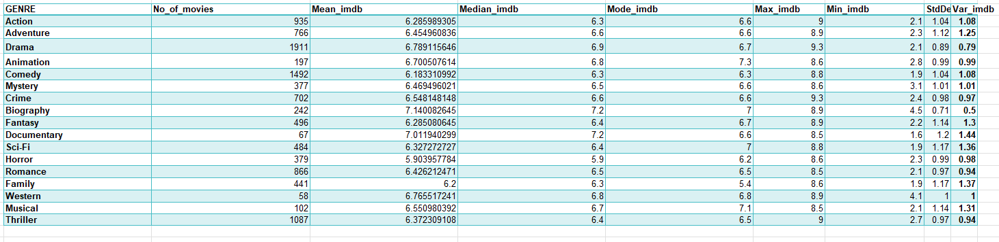
A. Movie Genre Analysis:
Analyze the distribution of movie genres and their impact on the IMDB score. Task: Determine the most common genres of movies in the dataset

Slide 8
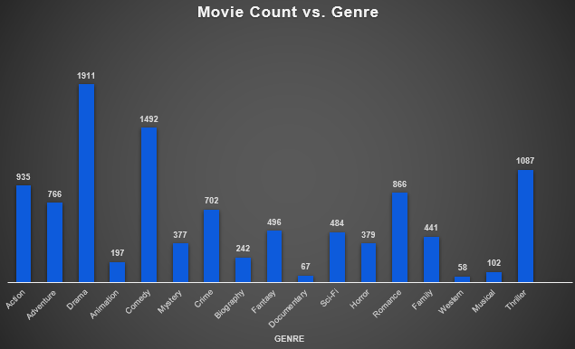
Top Genres are Drama followed by Comedy, Thriller.
Western and Documentary are the least ones

Slide 9
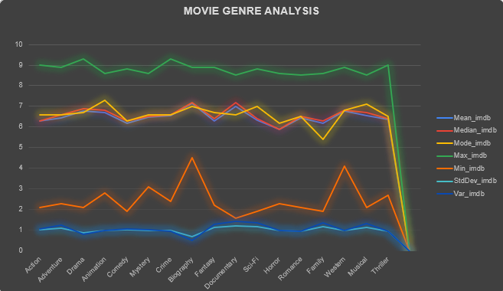
Top rated genres are Animation then Musical
Family has the lowest IMDB average

Slide 10
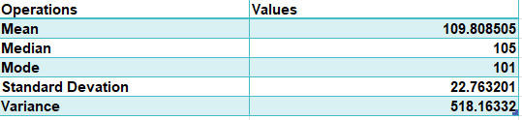
B. Movie Duration Analysis:
Analyze the distribution of movie durations and its impact on the IMDB score.
Task: Analyze the distribution of movie durations and identify the relationship between movie duration and IMDB score.

Slide 11
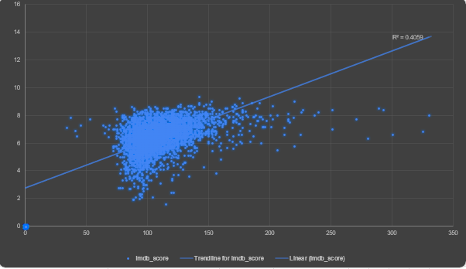
Movies with duration 100-110 min have highest rating.
Coefficient of Determination is low which shows the weak relationship between IMDB and movie duration.

Slide 12
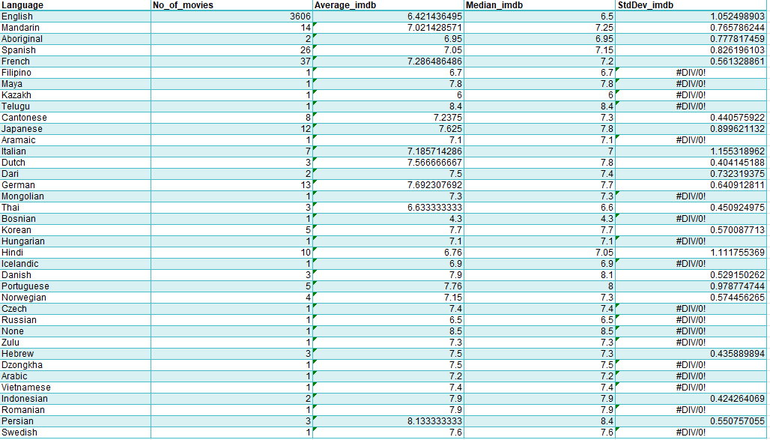
C. Language Analysis
Examine the distribution of movies based on their language.
Task: Determine the most common languages used in movies and analyze their impact on the IMDB score using descriptive statistics.
English language has the highest no. of movies followed by French.
Persian & Telugu language movies has the highest avg. rating.
Although ,English Language has max movies still its rating is lower.

Slide 13
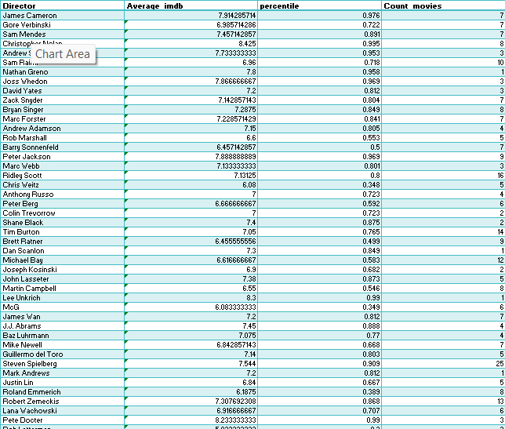
D. Director Analysis:
Influence of directors on movie ratings.
Task: Identify the top directors based on their average IMDB score and analyze their contribution to the success of movies using percentile calculations.
and so on…….

Slide 14
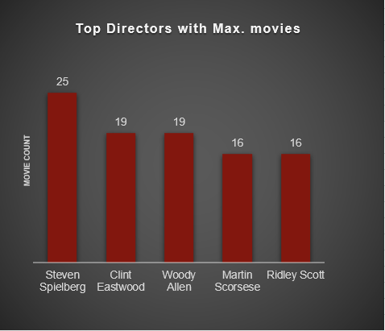
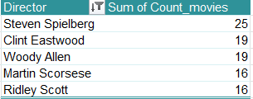
Steven Spielberg has done the max. movies i.e., 25.

Slide 15
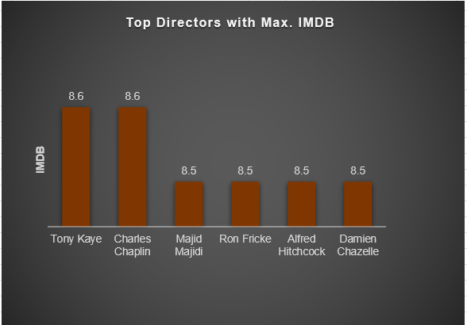
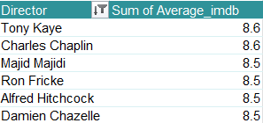
Tony Kaye & Charles Chaplin ‘s movies have highest rating of 8.6
Although their movies are high rated ,the no. of movies they make are low.

Slide 16
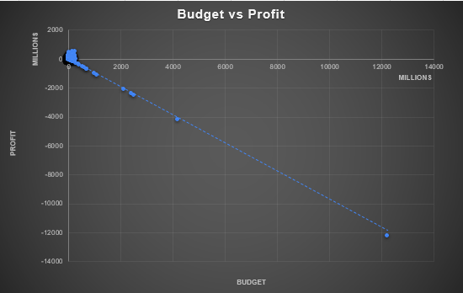
E. Budget Analysis
Explore the relationship between movie budgets and their financial success.
Task: Analyze the correlation between movie budgets and gross earnings and identify the movies with the highest profit margin.
Movies with high budget make losses
Low budget movies has high gross earnings

Slide 17
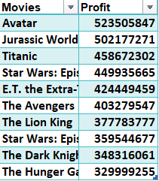
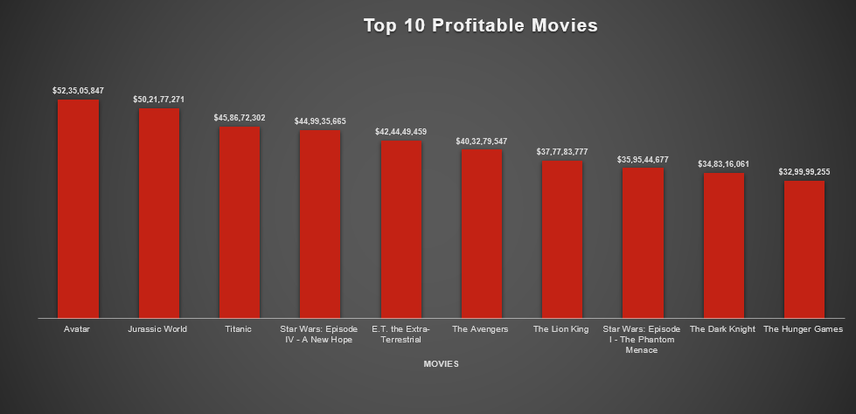
Avatar is the most profitable movie.

Slide 18
INSIGHTS
Drama, Comedy and Thriller genres have the max. movie share, but their IMDB ratings are low. On the other hand, Animation genre has very less movie share but has the highest rating.
Family genre has the lowest IMDB rating.
English Language has max movies,still its rating is low.
Steven Spielberg has done the max. movies i.e., 25 but has low avg. ratings
To ensure success budget should not be very high and the average duration should be 100-120 mins.

Slide 19
Results
This project helped me to excel my skills in Advanced Excel by working on functions, formulae, charts, pivot-tables , graphs etc.
Also, enhanced my Applied-Statistics knowledge by utilising various statistical concepts during analysis.

Slide 20
Links
Original Dataset
Cleaned and Post analysis- Dataset

Slide 21
Thank You !

